Slide 1

A MINOR PROJECT REPORT
ON
“Prestige Enclave”
Submitted in partial fulfilment of the requirement for the award of the degree of
MASTER OF COMPUTER APPLICATION
by
Mohd Shariq
(Roll No: 2023073034)
Submitted to
Ms. Pranjal Maurya
Assistant Professor, ITCA Dept.
DEPARTMENT OF INFORMATION TECHNOLOGY AND COMPUTER APPLICATION
MADAN MOHAN MALAVIYA UNIVERSITY OF TECHNOLOGY GORAKHPUR – 273010
SESSION – 2024-25
1

Slide 2
Declaration
I MOHD SHARIQ have completed the project titled “REAL ESTATE APPLICATION” under the guidance of Ms. Pranjal Maurya in the partial fulfilment of the requirement for the award of Degree of Masters of Computer Application of Madan Mohan Malaviya University of Technology, Gorakhpur. This is an original piece of work & I have neither copied and nor submitted it earlier elsewhere.
Mohd Shariq
Roll No: 2023073034
Masters of Computer Application
Madan Mohan Malaviya University of Technology Gorakhpur
2

Slide 3
Certificate
This is to certify that the project titled “THE REAL ESTATE APPLICATION” is an academic work done by “Mohd Shariq” submitted in the partial fulfilment of the requirement for the award of the Degree of “Masters of Computer Application” from “Madan Mohan Malaviya University of Technology, Gorakhpur” under my guidance & direction. To the best of my knowledge and belief the data & information presented by him in the project has not been submitted earlier.
Ms. Pranjal Maurya
(Project Supervisor)
3

Slide 4
Acknowledgement
I am extremely grateful and remain indebted to my guide Ms. Pranjal Maurya for being a source of inspiration and for their constant support in the Design, Implementation and Evaluation of the project. I am thankful for constant constructive criticism and invaluable suggestions, which benefited me a lot while developing the project on “THE REAL ESTATE APPLICATION”. With candour and pleasure, I take the opportunity to express my sincere thanks and obligation to the faculty members. Through this column, it would be my utmost pleasure to express my warm thanks to them for the encouragement, co-operation and consent without which I mightn’t be able to accomplish this project.
Mohd Shariq
4

Slide 5
Abstract
Real Estate application aims to simplify property browsing, management, and transactions for buyers, sellers, and agents. Leveraging the power of the MERN stack (MongoDB, Express.js, React, and Node.js), the platform delivers a responsive and seamless experience across all devices. It allows users to explore a wide range of property listings with advanced filtering options, making it easier to find the perfect match based on location, budget, and preferences.
The application integrates secure user authentication using Firebase, ensuring data protection and reliability. Personalized dashboards provide users with valuable insights into property performance, views, and engagement, making it a comprehensive solution for property management. With dynamic search capabilities and intelligent recommendations, users are presented with properties tailored to their interests, enhancing the overall user experience.
The real estate application offers a fast and intuitive interface powered by Vite. Its interactive features, including a built-in chat and inquiry system, facilitate direct communication between buyers and sellers or agents. The platform aims to revolutionize the real estate industry by bridging gaps in traditional property transactions and creating a transparent, user-friendly digital ecosystem.
5

Slide 6
Table of Contents
1. Introduction ……………………………………………………………………….. 7
1.1 Overview ...……………………………………………………………………... 7
1.2 Objective ……………………………………………………………………….. 7
2. Technology Description …………………………………………………………… 9
2.1 Frontend Technologies ………………………………………………………….. 9
2.2 Backend Technologies ………………………………………………………….. 9
2.3 Software Requirements ………………………………………………………… 9
2.4 Hardware Requirements ………………………………………………………. 10
3. Flow Chart….. …………………………………………………………………….. 11
4. Modules …………………………………………………………………………... 12
4.1 Home Page Module …………………………………………………………… 12
4.2 Listing Results ………………………………………………………………....12
4.3 Login And Signup Module ……………………………………………………. 13
5. Project Screenshot ……………………………………………………………….. 14
5.1 Home Page Section ... ……………………………………………………….…. 14
5.2 Signup Page..…………………………………………………………………... 15
5.3 Signin Page.. . …. ……………………………………………………………….. 15
5.4 Profile Page .....………………………………………………………………… 16
5.5 About Section .. ..……………………………………………………………….. 16
5.6 Create Listing Page. …………………………………………………………… 17
5.7 Update Listing Page (only for Admin) .………………………………………… 18
5.8Smart Property Search & Filters …………………………………..………….....19
5.9 See Listing and Contact Landlord …...……………………………………… ..20
6. Future Scope ……………………………………………………………………… 21
7. Conclusion ………………………………………………………………………... 22
8. References ………………………………………………………………………... 23
6

Slide 7
1. Introduction
1.1 Overview
In the rapidly evolving landscape of technology, our real estate application is designed to provide a seamless, user-friendly platform for property browsing, management, and transactions. This comprehensive solution caters to the needs of buyers, sellers, and agents, ensuring a transparent and efficient property management system. It offers a modern and interactive experience with innovative features, enhancing the overall usability for all stakeholders.
Key Features:
Intuitive Interface for Property Browsing: The platform includes a visually appealing and user-friendly interface, allowing users to easily explore an extensive range of property listings.
Authentication System for Different Users: To ensure secure interactions and data protection, the application incorporates a robust user authentication system using Firebase. This enables users to create accounts and securely access their personalized dashboards.
Property Management Features (Upload, Edit, Delete): Sellers and agents can manage property listings effortlessly with options to upload, update, or delete property details. This ensures an up-to-date and dynamic collection of listings.
Admin Verification of Listings: Administrators play a crucial role in maintaining data integrity and quality by verifying and approving property listings before they are visible to users. This ensures reliability and trustworthiness across the platform.
This project envisions a modern and accessible online real estate platform while addressing the challenges of managing property listings and transactions efficiently. By carefully focusing on user experience and functionality, the application is designed to cater to the diverse needs of property buyers, sellers, and agents. Through innovative features and a user-friendly interface, the platform aims to bridge the gap between traditional real estate practices and the conveniences of digital technology.
2.2 Objective
Our project is driven by a set of clear and strategic objectives, aimed at delivering a robust online real estate platform with efficient property management. The key goals include:
Enhance User Experience:
Develop an intuitive and visually appealing user interface that ensures a seamless and enjoyable experience for users browsing on the website.
7

Slide 8
Implement Secure Authentication:
Establish a secure and user-friendly authentication system to enable different users to create accounts, log in securely, and access personalized features while maintaining the confidentiality of their data.
Facilitate Property Management:
Enable users to easily manage property listings by providing tools to upload, edit, and delete properties. This ensures the platform remains up-to-date and that property details are accurately represented.
Ensure Data Integrity through Admin Verification:
Implement an admin verification system to ensure the accuracy and reliability of property listings. Admins will review and approve user-submitted listings before they go live, maintaining the integrity of the platform and providing users with trustworthy information.
Promote Collaboration and Accessibility:
Foster seamless communication between buyers, sellers, and agents through integrated messaging and collaboration tools. Ensure the platform is accessible across all devices, providing a smooth and inclusive experience for users on mobile, tablet, or desktop.
Ensure Scalability and Maintainability:
Design the platform to handle increasing user traffic and property listings efficiently. Implement a flexible architecture that allows for easy updates and maintenance, ensuring the application can grow with evolving user needs and market demands.
Adhere to Best Practices and Security Standards:
Implement industry best practices for web development, ensuring the security and privacy of user data. Adhere to coding standards, conduct regular security audits, and prioritize the protection of sensitive information.
By addressing these objectives, our project aims to create a comprehensive and sustainable solution that not only meets the immediate needs of users but also lays the foundation for future growth and innovation in the realm of real estate management, offering a seamless and efficient experience for buyers, sellers, and agents.
8

Slide 9
2. Technology Description
2.1 Frontend Technologies
HTML: The project's user interface is built using HTML to structure the content and create a foundation for dynamic web pages.
Tailwind CSS: For styling and responsive design, Tailwind CSS is utilized. It provides a utility-first approach, making it efficient for styling components and ensuring a consistent and visually appealing user interface.
JavaScript and React: The project leverages JavaScript as the primary scripting language and utilizes the React library for building interactive and dynamic user interfaces. React enables the creation of reusable components, facilitating a modular and maintainable codebase.
Netlify Hosting: The frontend application is hosted on Netlify, providing a scalable and performant hosting solution. Netlify's continuous deployment ensures automatic updates whenever changes are pushed to the version control system.
2.2 Backend Technologies
Express.js: As a lightweight and flexible Node.js framework, Express.js is employed for building the backend server. It simplifies the handling of HTTP requests, routing, and middleware integration.
Node.js: The server-side runtime environment is powered by Node.js, providing a scalable and efficient platform for executing server-side code.
MongoDB: A NoSQL database, MongoDB is chosen for its flexibility and scalability. It stores book information, user data, and inventory details in a structured manner.
Firebase Authentication: Firebase is used for user authentication, providing a secure and reliable authentication system. It supports various authentication methods, including email/password, ensuring a seamless login experience for users.
Render Hosting: The backend application is hosted on Render, offering a reliable platform for server deployment with automatic scaling and continuous integration.
2.3 Software Requirements
Code Editor: Any code editor of choice, such as Visual Studio Code, Atom, or Sublime Text, is required for development.
Node Package Manager (NPM): The project relies on NPM for managing dependencies and running scripts. Ensure the latest version of Node.js is installed to utilize NPM.
9

Slide 10
MongoDB Atlas: MongoDB Atlas, a cloud-based database service, is utilized for hosting and managing the MongoDB database. A MongoDB Atlas account is required for database setup.
2.4 Hardware Requirements
The hardware requirements for development are minimal, requiring a standard computer or laptop with sufficient processing power and RAM to comfortably run development tools and services.
By leveraging Netlify and Render, the project ensures a modern, scalable, and secure architecture that caters to the dynamic requirements of an online bookstore with inventory management.
10

Slide 11
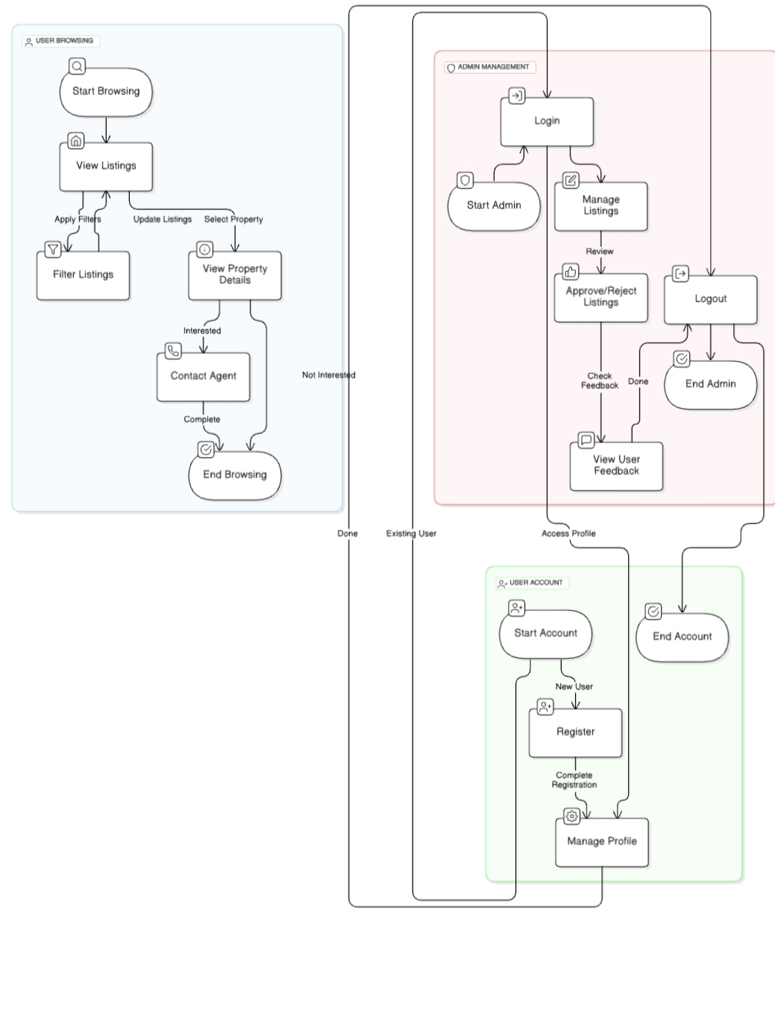
3. Flow Chart

Slide 12
4. Modules
4.1 Home Page Module:
Objective:
Engaging Introduction: Create a welcoming and visually appealing introduction to the real estate platform, highlighting featured properties, promotions, and key updates on the home page.
Easy Navigation: Design an intuitive interface that allows users to easily navigate through the website, providing seamless access to different sections and property listings.
Key Features:
Dynamic Content: Leverage dynamic content rendering to showcase changing properties, featured listings, and ongoing promotions in real-time, keeping the page fresh and engaging..
Responsive Design: Ensure the home page is fully responsive, providing an optimal viewing experience across all devices, whether it’s a desktop, tablet, or smartphone.
Navigation Elements: Incorporate user-friendly navigation elements, such as a clean and clear menu, quick links, and search options, to help users easily explore the website and find what they’re looking for.
4.2 Listings Results:
Objective:
Comprehensive Property Listing: Display an extensive catalog of all properties available in the database, allowing users to explore a wide range of real estate options.
User-Friendly Browsing: Provide users with the ability to browse and search properties based on various criteria, ensuring a seamless and personalized exploration experience.
Key Features:
Dynamic Rendering: Fetch and dynamically render property listings from the MongoDB database, guaranteeing that the displayed listings are always accurate and up-to-date.
Detailed Book Display: Offer users the ability to view detailed information about a property, including images, descriptions, and specifications, by clicking on its listing.

Slide 13
4.3 Login and Signup Module:
Objective:
User Authentication: Facilitate user authentication to enable personalized experiences and secure access to user-specific data.
Seamless Process: Ensure a secure and seamless login/signup process, encouraging users to engage with the platform.
Key Features:
User-Friendly Forms: Design user-friendly login and signup forms for a positive user experience.
Firebase Integration: Integrate Firebase Authentication to manage user accounts securely.

Slide 14
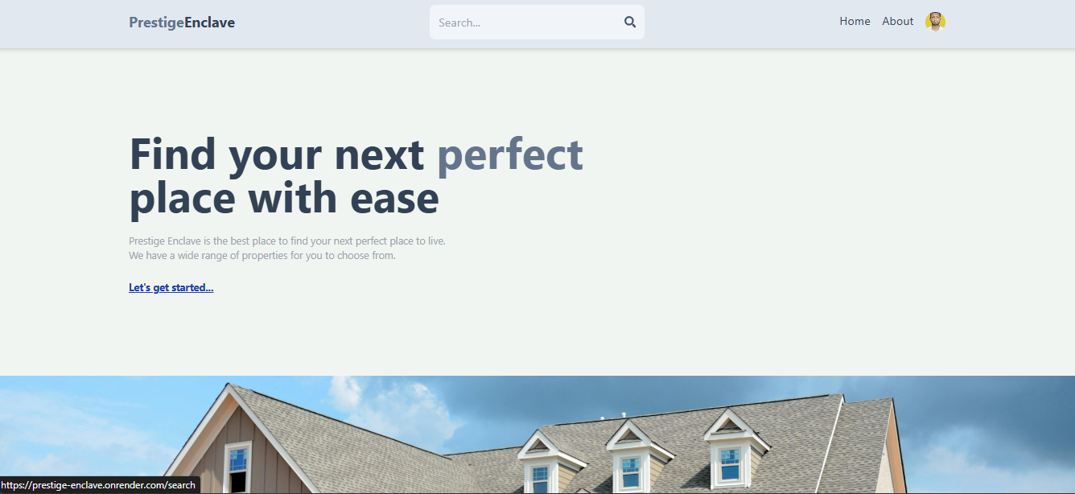
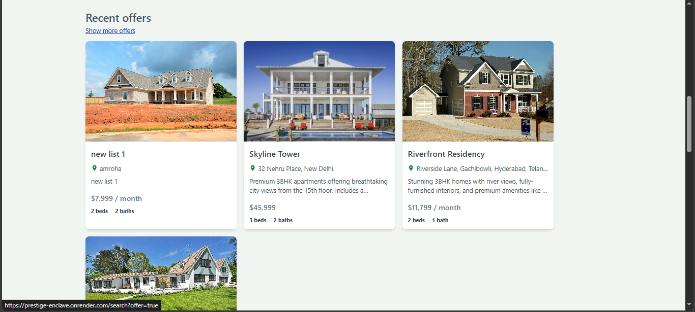
5. Project Screenshot
5.1 Home Page Section 1 & 2

Slide 15
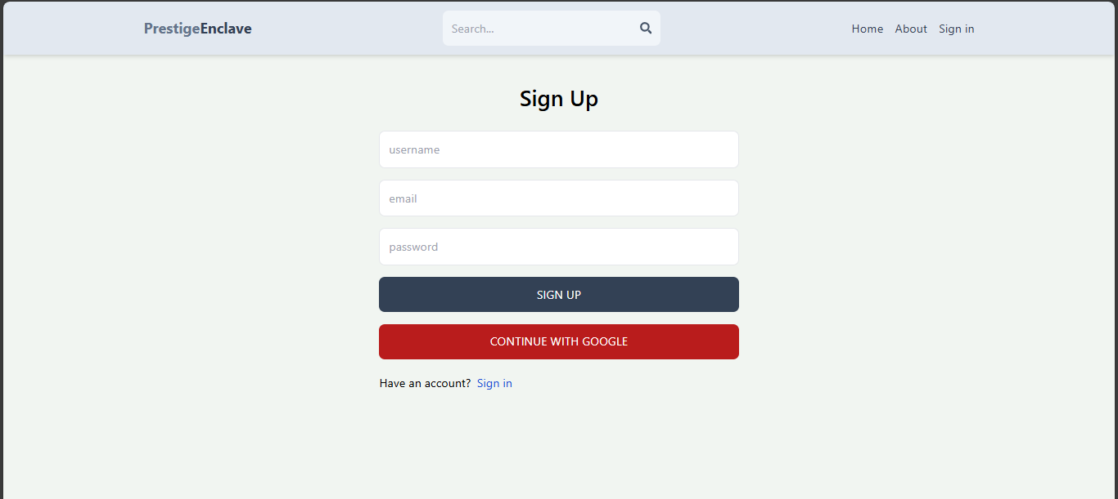
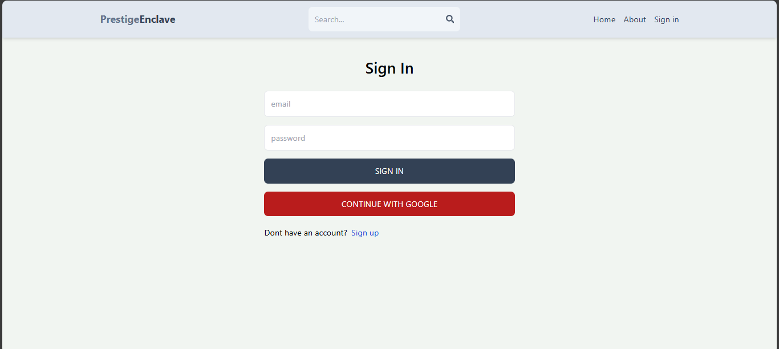
5.2 Sign Up Page
5.3 Sign In Page

Slide 16
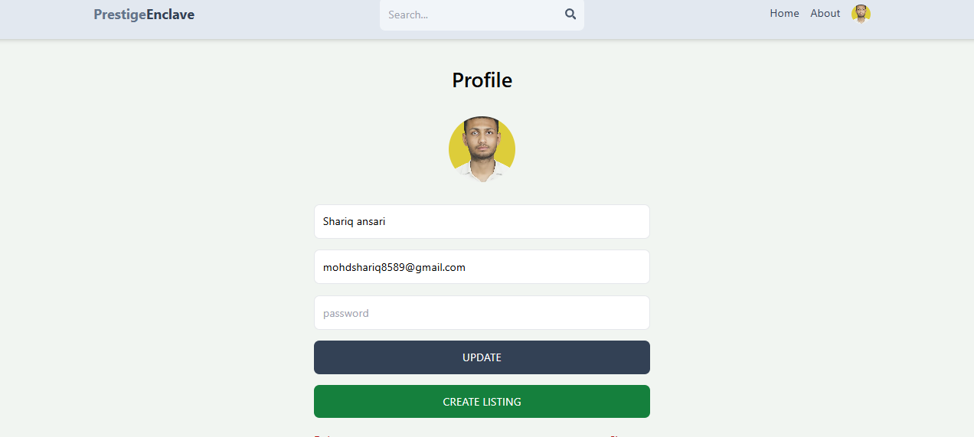
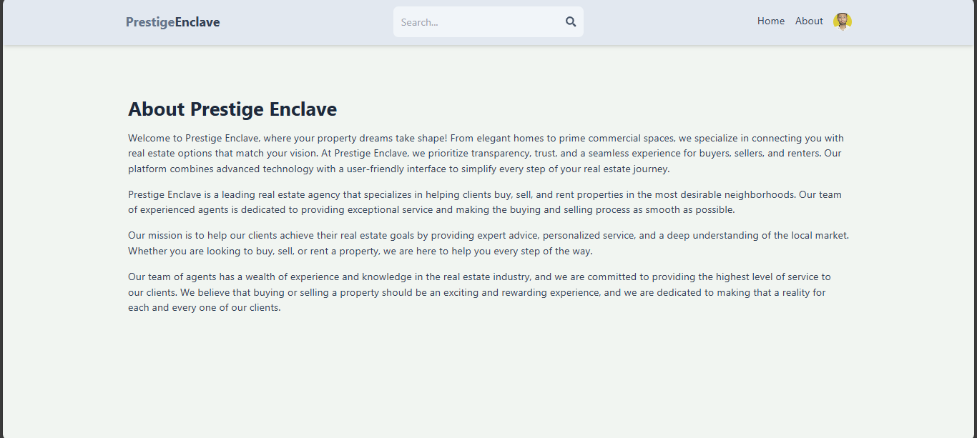
5.4 Profile Page
5.5 About Page

Slide 17
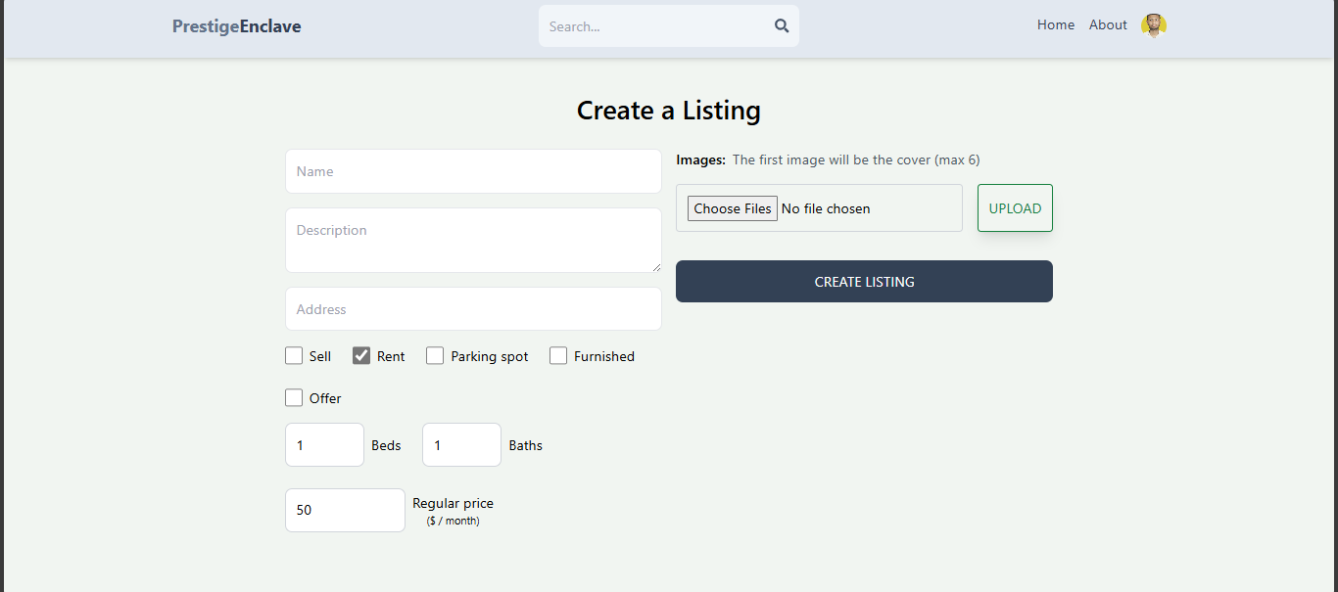
5.6 Create Listing Page

Slide 18
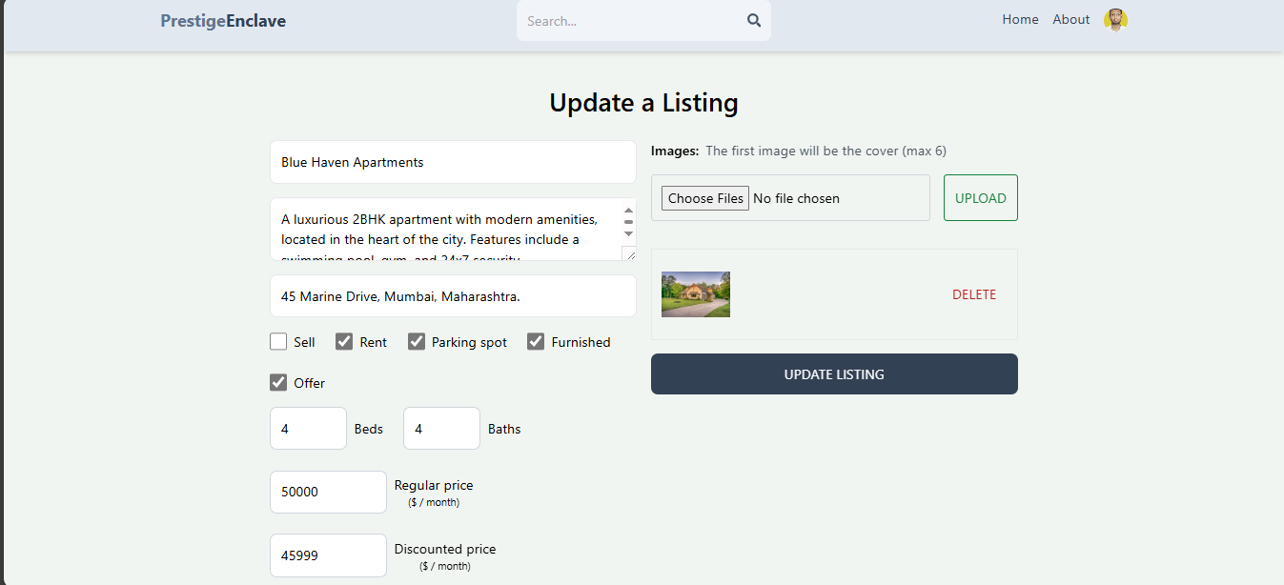
5.7 Update Listing Page (Only for admin)

Slide 19
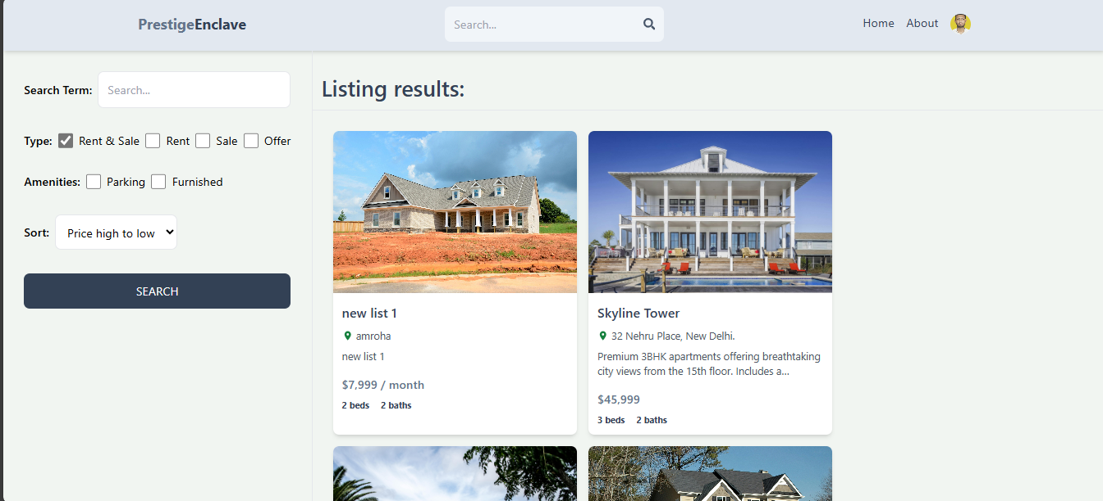
5.8 Smart Property and Search Filters

Slide 20
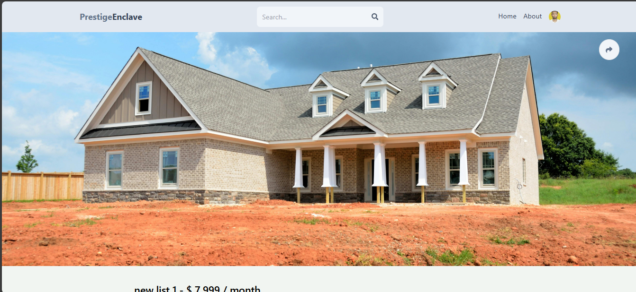
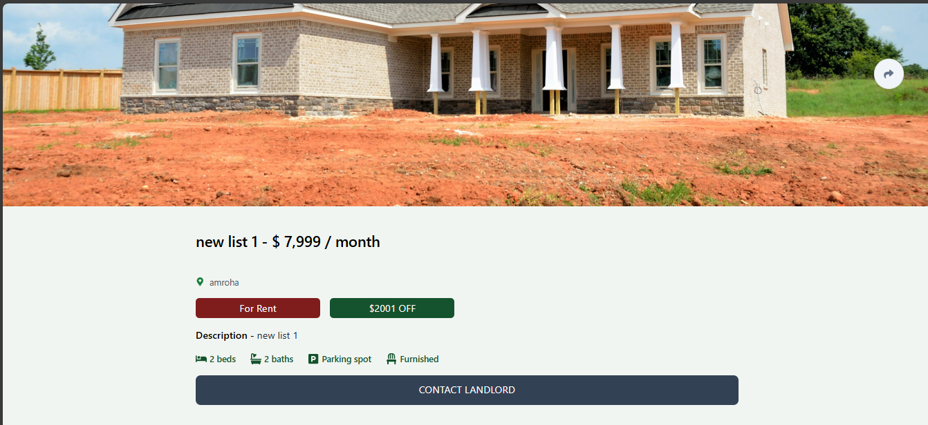
5.9 See Listing and Contact Landlord
20

Slide 21
6. Future Scope
The future of the real estate application is shaped by continuous innovation and the integration of advanced technologies. As user needs evolve and the market progresses, there are several key areas where the platform can grow to enhance functionality, security, and overall user experience.
AI Property Recommendations:
The integration of Artificial Intelligence (AI) will enable the application to provide personalized property recommendations based on users’ preferences, browsing history, and previous interactions. This intelligent feature will not only make property searches faster but will also ensure that users find properties that best match their needs, whether it’s by location, price range, or property type.
User Reviews and Ratings:
A robust review and rating system will allow users to leave feedback on properties, agents, and their overall experience with the platform. This will build trust and transparency, enabling future users to make more informed decisions based on the experiences of others. Reviews and ratings will also help improve the platform by identifying areas of improvement and providing valuable insights to property sellers and agents..
Payment Gateaway Integration:
Introducing a secure and seamless payment gateway within the platform will streamline the property transaction process. Users will be able to make payments for property reservations, deposits, and even full purchases directly through the application. By supporting various payment methods, such as credit/debit cards and digital wallets, this feature will improve the convenience and security of financial transactions for both buyers and sellers.
Virtual and Augmented reality(VR/AR) Integration:
By incorporating VR and AR technologies, the platform can offer immersive virtual tours of properties, allowing users to explore homes without the need for in-person visits. AR features could further enhance property viewing by enabling users to visualize potential renovations, furniture placement, or smart home devices in the property.

Slide 22
7. Conclusion
In conclusion, the real estate application serves as an innovative platform designed to meet the growing demands of the real estate industry while enhancing the overall user experience. By incorporating key features such as AI-driven property recommendations, secure payment gateway integration, and a transparent review and rating system, the platform offers users a seamless and efficient way to navigate the property market. Whether it’s a buyer searching for their dream home, a seller looking to list their property, or an agent managing multiple listings, the application provides an all-encompassing solution for every user.
The future scope of the project, which includes integrating advanced technologies like VR/AR, blockchain for secure transactions, and smart home features, positions the platform as a forward-thinking and adaptable solution that will continue to evolve alongside industry trends. By leveraging these cutting-edge technologies, the platform not only makes property searches more efficient but also creates an immersive and secure experience for users, enhancing both trust and convenience in property transactions.
Additionally, the platform's scalability ensures that it can handle growing user bases and increasing property listings without compromising on performance. As the real estate market continues to expand and evolve, this application is well-positioned to meet future challenges, offering a comprehensive and sustainable solution for property buyers, sellers, and agents alike.
Ultimately, this project aims to redefine the way real estate transactions are conducted, offering a seamless, transparent, and user-centric experience. Through continuous updates, enhancements, and integration of emerging technologies, the real estate application will not only remain at the forefront of the industry but also contribute to the broader vision of a more connected, efficient, and user-friendly real estate ecosystem.

Slide 23
8. References
react.dev/learn
w3schools.com
expressjs.com/en/starter/installing.html
swiperjs.com/demos
firebase.google.com/docs/web/setup
youtube.com
mongodb.com/docs/manual/crud
https://github.com/mohdsha-123
flowbite-react.com/docs/getting-started/introduction
react-icons.github.io/react-icons

